Slide 1
Logistic Regression
Intuition

Slide 2
Logistic Regression
Introduction :
Logistic regression is a classification algorithm used to assign observations to a discrete set of classes.
Unlike linear regression which outputs continuous number values, logistic regression transforms its output using the logistic sigmoid function to return a probability value which can then be mapped to two or more discrete classes.

Slide 3
Logistic Regression
Types of Logistic Regression :
Binary Logistic Regression :
- Here, the dependent variable “y” is binary in nature i.e,
y = 1 or 0 .
Multiclass logistic regression :
- Instead of y=0,1 we will expand our definition so that
y=0,1...n. Basically we re-run binary classification multiple
times, once for each class.

Slide 4
Logistic Regression
Before moving ahead let us recap what we have done so far : -
Linear Regression
^
- Simple : y = w₀ + w₁ * x
^
- Multivariate : y = w₀ + w₁ * x₁ + ... + w_{n} * x_{n}
^
- Polynomial : y = w₀ + w₁ * x₁ + w₂ * x₁²... + w_{n} * x₁^{n}

Slide 5
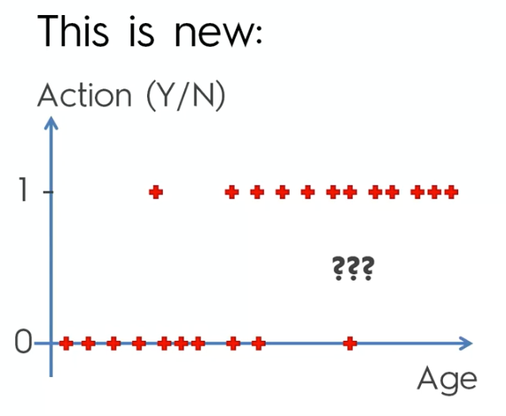
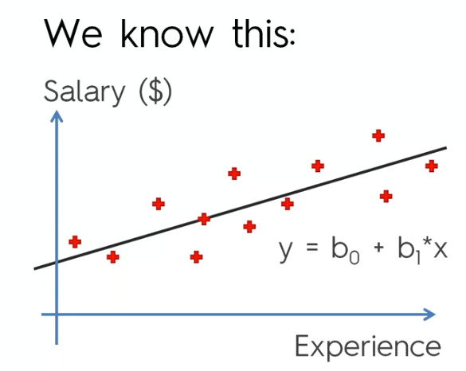
Logistic Regression
Binary Classification :
You have to predict was the action taken or not ? (Yes =1 or No = 1)
We use Simple Linear Regression and put the best fitting line through the data

Slide 6
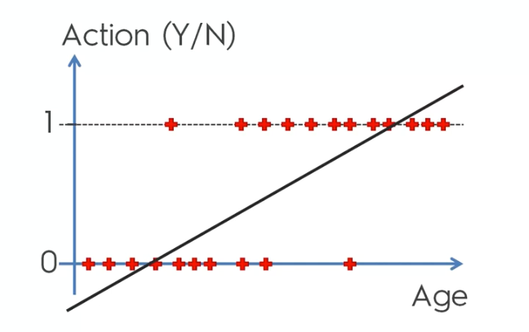
Logistic Regression
Problem Statement Description :
Your company has sent offer letters to customers to buy certain products. You have their age and also whether or not they took action. You have to build a model that predicts was the action taken (Yes = 1 or No =0 ) for any given age .
Can we apply Linear Regression ?
Based on Intuition :
The older people are more likely to take action (Yes =1 ) than the younger people (No = 0 ).

Slide 7
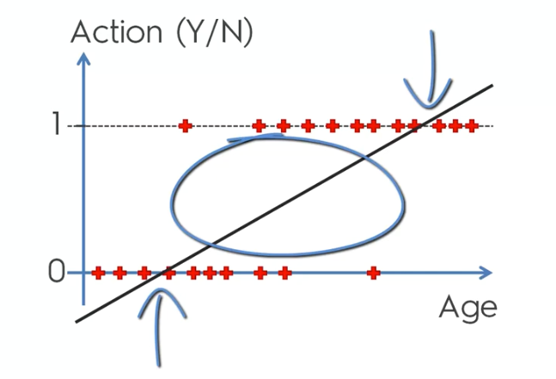
Logistic Regression
Let’s interpret this in a different way :
Instead of predicting exactly (Yes =1 or No = 0 ) , we can calculate the probability of that person taking up that offer.
We know that probabilities vary from 0 to 1 . Also , the linear regression line in the middle varies from 0 to 1.
We can interpret that as the age of the person increases , the probability of that person taking up the offer also increases.
Q) How to make the actual prediction ?
Ans : We can set a threshold for the probabilities for eg. 0.5 . Anything above 0.5 will be considered as 1 (Action = Yes) and anything below 0.5 will be considered 0 (Action = No).

Slide 8
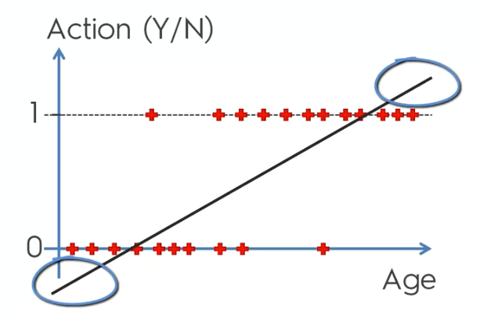
Logistic Regression
The parts of the Linear regression line that do not make sense at all are at the top and the bottom.
Probabilities can never be less than 0 or greater than 1.
Therefore, Linear Regression is not a good choice for classification problems.
Linear Regression is not the best option.

Slide 9
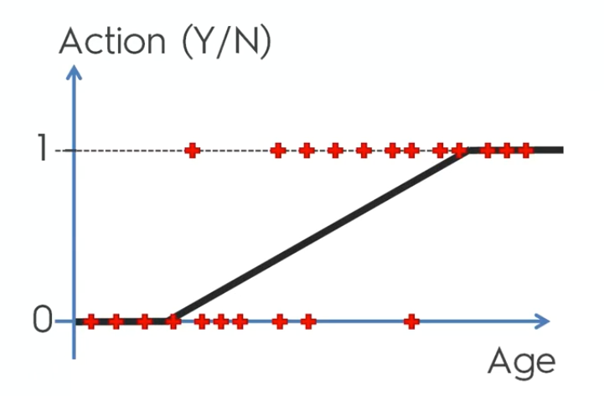
Logistic Regression
We could restrict the Linear Regression Line to vary from 0 to 1.
OR ,
We could use the Sigmoid Function.

Slide 10

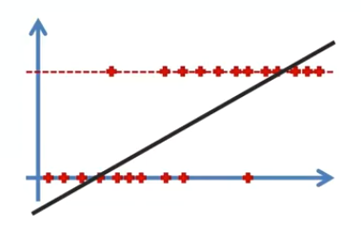
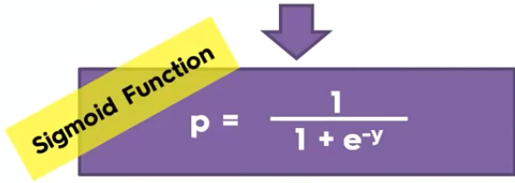
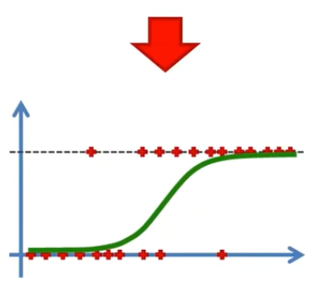
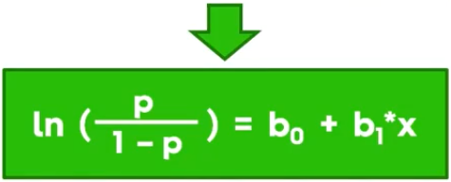
Logistic Regression

Slide 11


Logistic Regression

Slide 12
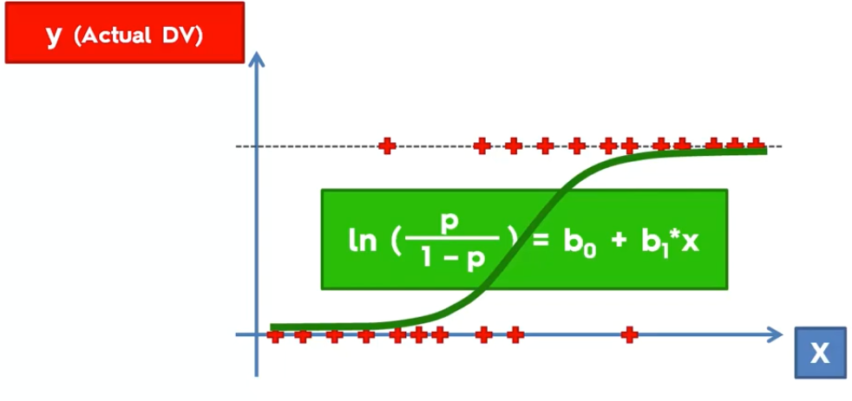
Logistic Regression
Based on the observations and the Logistic Regression Formula , we come up with this curve. This curve is the best fitting curve for the given dataset.

Slide 13
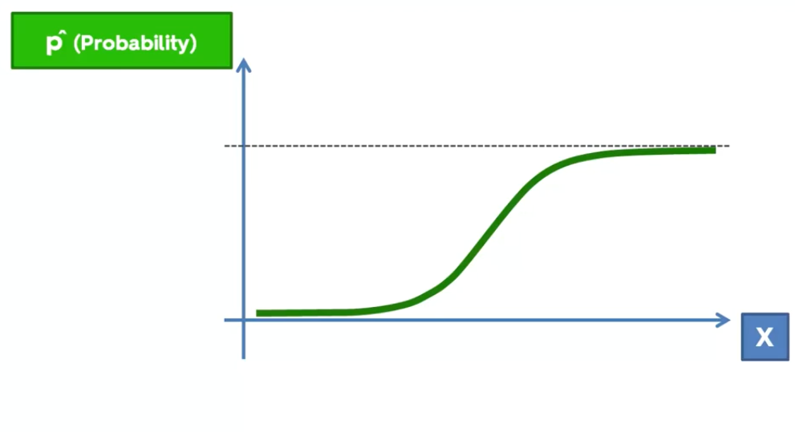
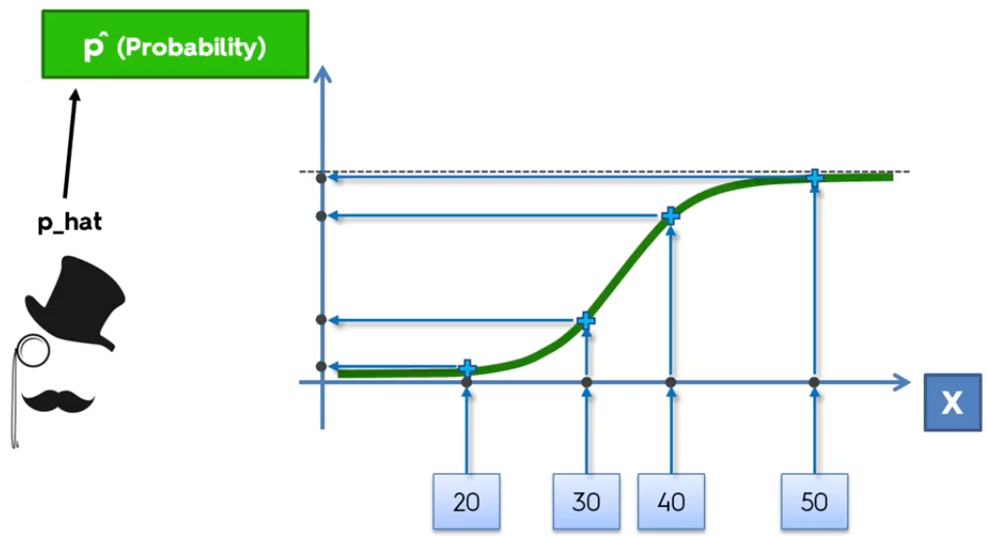
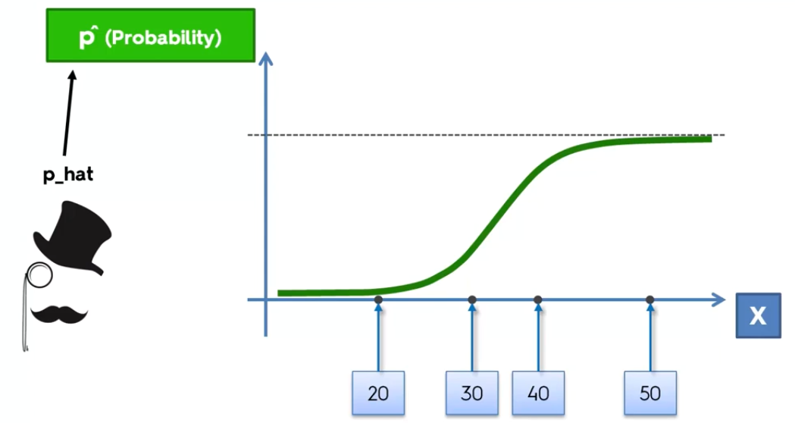
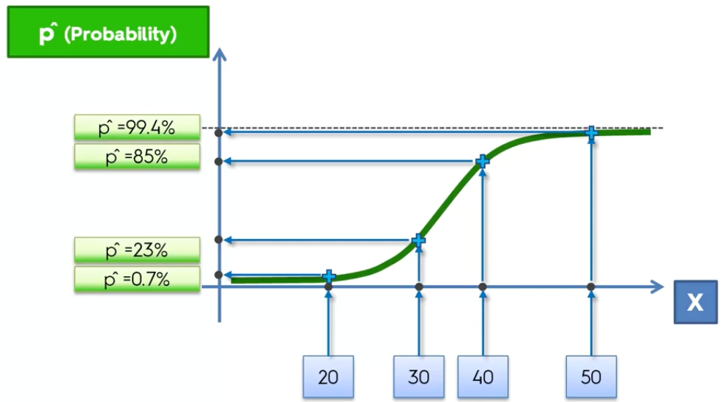
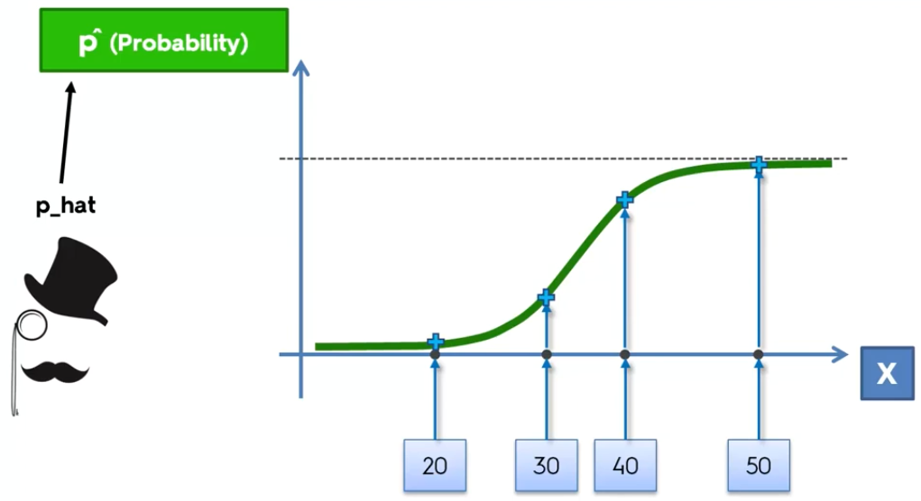
Logistic Regression

Slide 14
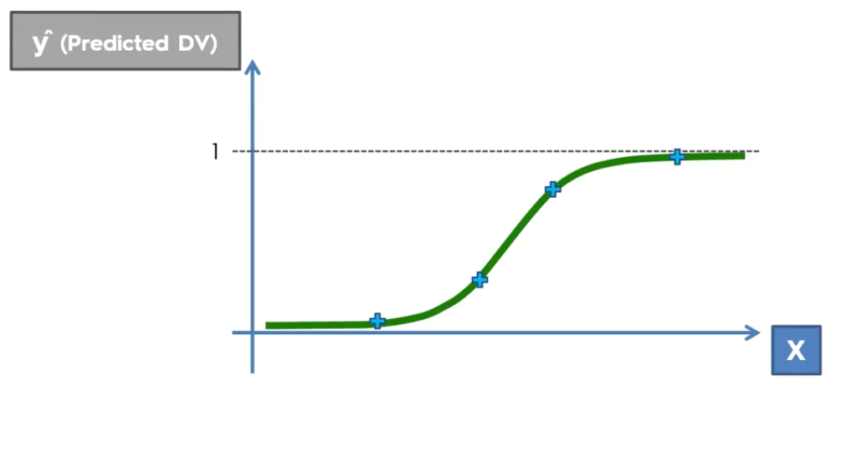
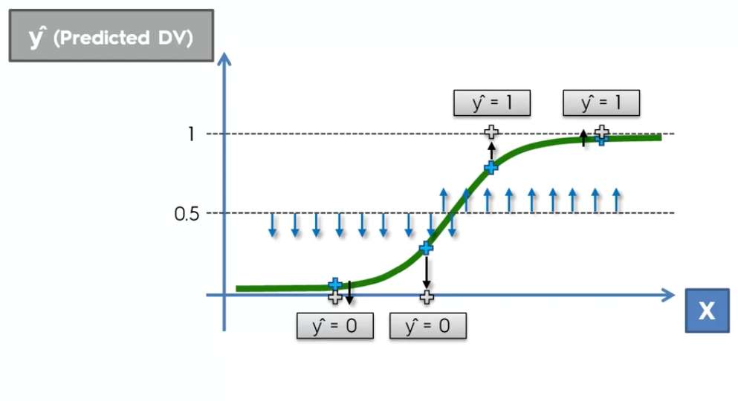
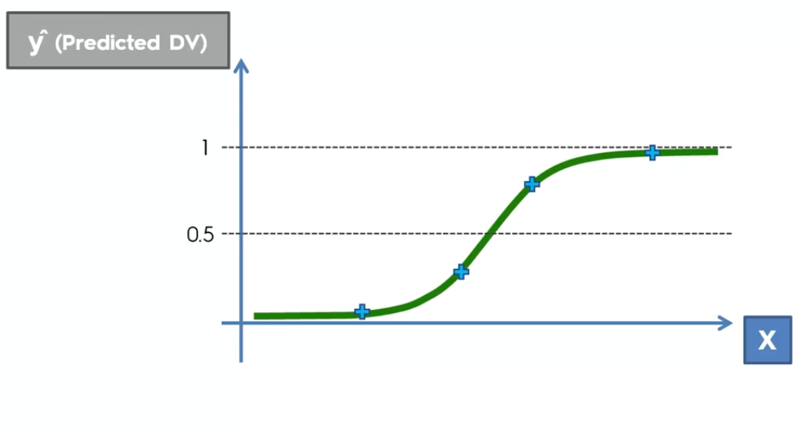
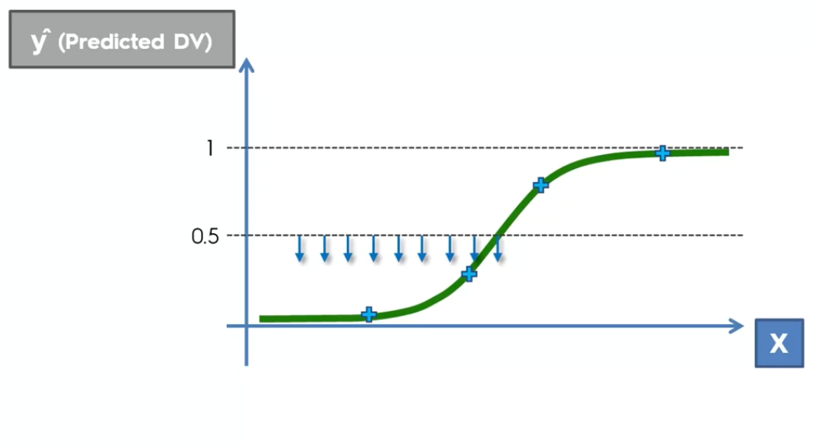
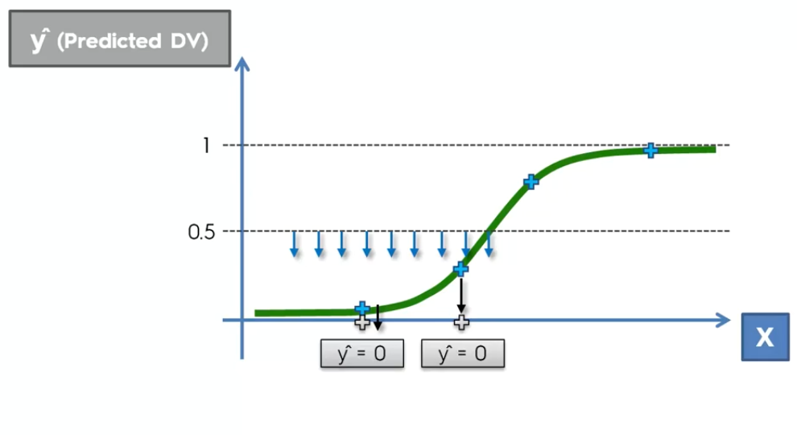
Logistic Regression

Slide 15
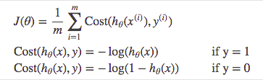
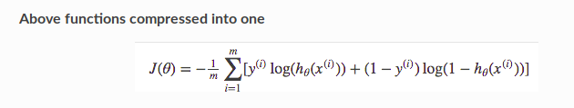
Logistic Regression
Cost Function :
Instead of Mean Squared Error, we use a cost function called Cross-Entropy, also known as Log Loss. Cross-entropy loss can be divided into two separate cost functions: one for y=1 and one for y=0.
.

Slide 16
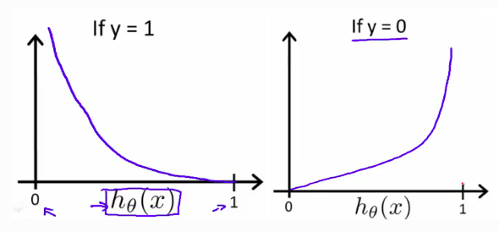
Logistic Regression
Cost Function Graph :
The benefits of taking the logarithm reveal
themselves when you look at the cost function graphs for y=1 and y=0.
These smooth monotonic functions (always increasing or always decreasing) make it easy to calculate the gradient and minimize cost.
The key thing to note is the cost function penalizes confident and wrong predictions more than it rewards confident and right predictions!
The corollary is increasing prediction accuracy (closer to 0 or 1) has diminishing returns on reducing cost due to the logistic nature of our cost function.

Slide 17
Logistic Regression
Let’s Code !

